Slide 1
In The Name Of God
Aref Honarparvaran
Master Student of Chemical Engineering
Application of Nanoparticles in Protein Purification
99-00 Semister

Slide 2
Protein Purification
Protein purification is a series of processes intended to separate one or a few proteins from a complex mixture, usually cells, tissues or whole organisms. Protein purification plays an important role in theranostics (Therapy & diagnosis)

Slide 3
NanoParticle Applications in Protein Purification
Affinity Chromatography
Covalent Bonding
Hydrogels

Slide 4
Affinity Chromatography
All chromatography methods consist of three parts. Stationary phase, Mobile phase and Analyte. Separation of a desired protein using affinity chromatography relies on the reversible interactions between the protein to be purified (Analyte) and the affinity ligand coupled to chromatographic matrix (Stationary phase). In the end elution step will help us to separate the target protein from ligand and chromatographic matrix.

Slide 5
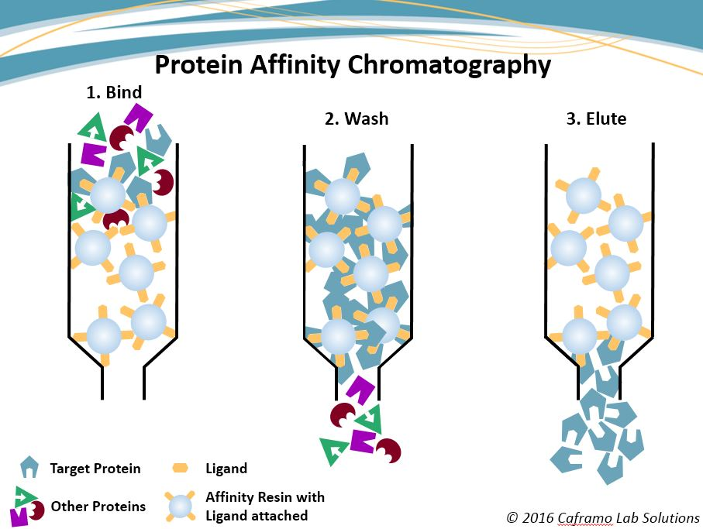

Slide 6
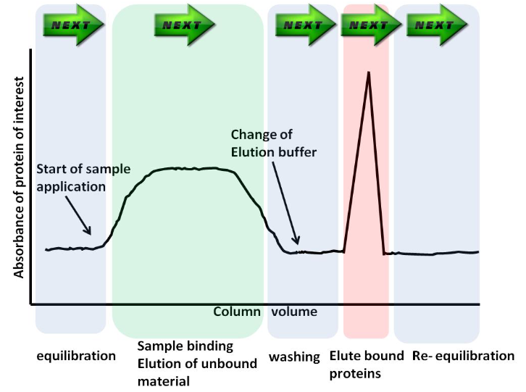
Affinity Chromatography

Slide 7
Applications of NanoParticles in Affinity Chromatography
Increasing Mechanical Strength
Increasing Porosity and Surface Area of The Beads
Modifying of Pore Size Distribution
Enhancing Protein Molecule Binding to Ligands
Adding NPs

Slide 8
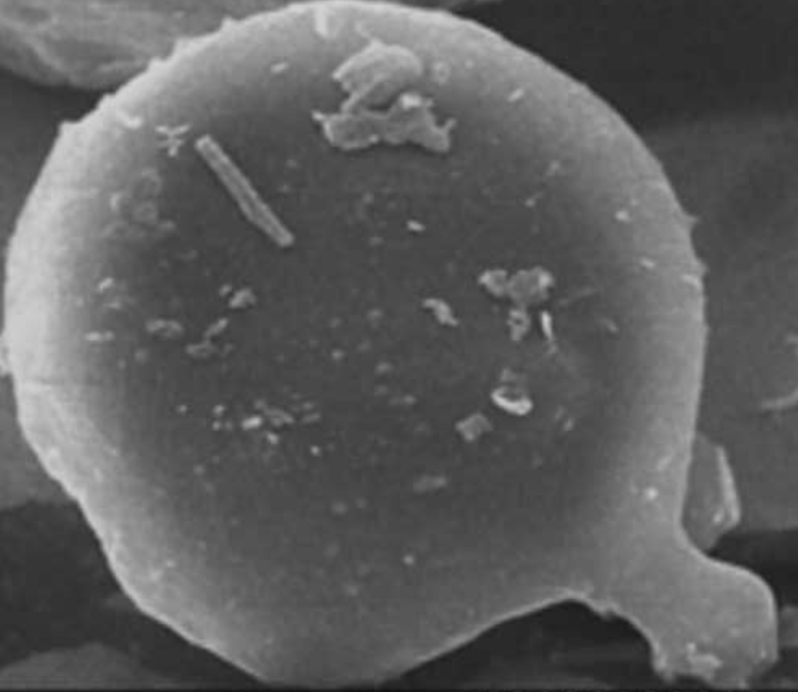
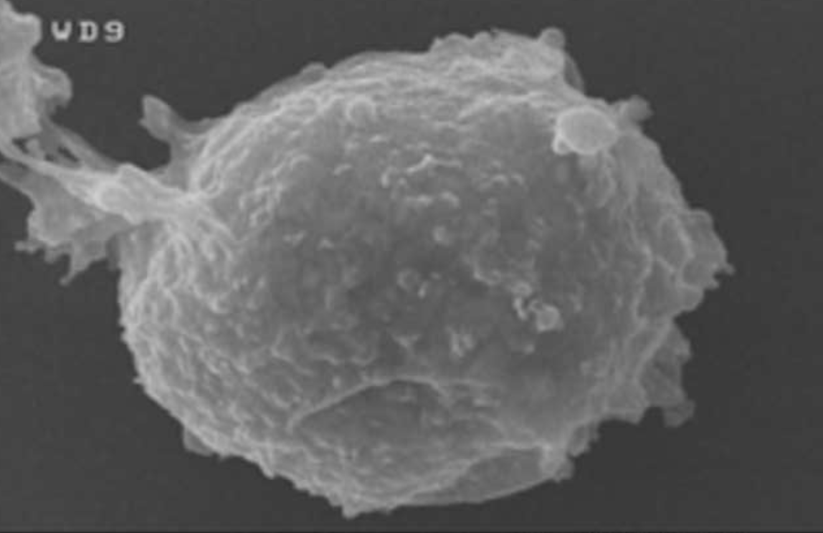
Non-magnetic bead
Magnetic bead

Slide 9
Covalent Bonding
In this method stable complexes between functional groups on enzyme molecules and a support matrix are formed through covalent bondings. The functional group present on enzyme, through which a covalent bond with support could be established, should be non-essential for enzymatic activity which usually involves binding via the side chains of lysine (ε-amino group),cysteine (thiol group) and aspartic and glutamic acids(carboxylic group).

Slide 10
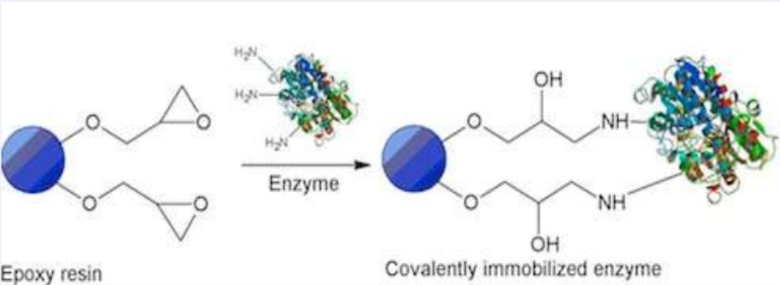
Covalent Bonding

Slide 11
Enzyme
Amino groups, Imino groups
Hydroxyl group
Carboxyl group
Thiol & Methylthiol group
Guanidyl & Imidazole group
Phenol rings
Support
Alpha carboxyl group
Alpha carboxyl group
Alpha amino group
Epsilon amino group
Beta & gamma carboxyl group
Phenol ring of Tyrosine
Thiol group of cysteine
Hydroxyl group of Serine & Threonine
Imidazole group of Histidine

Slide 12
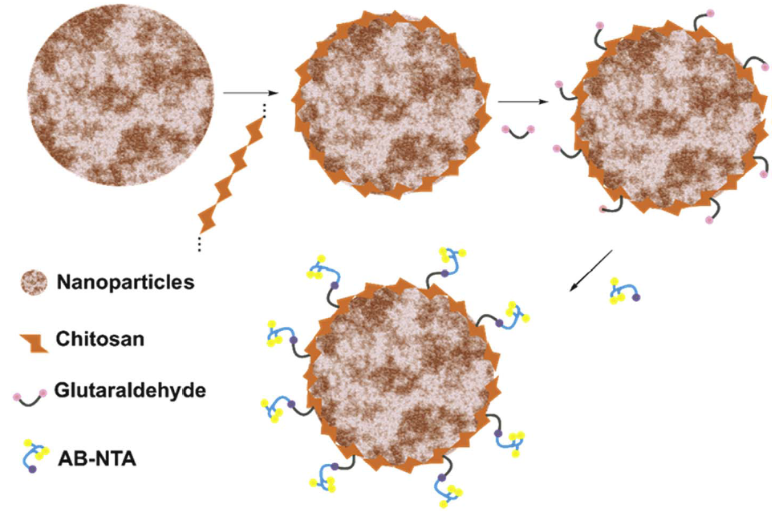
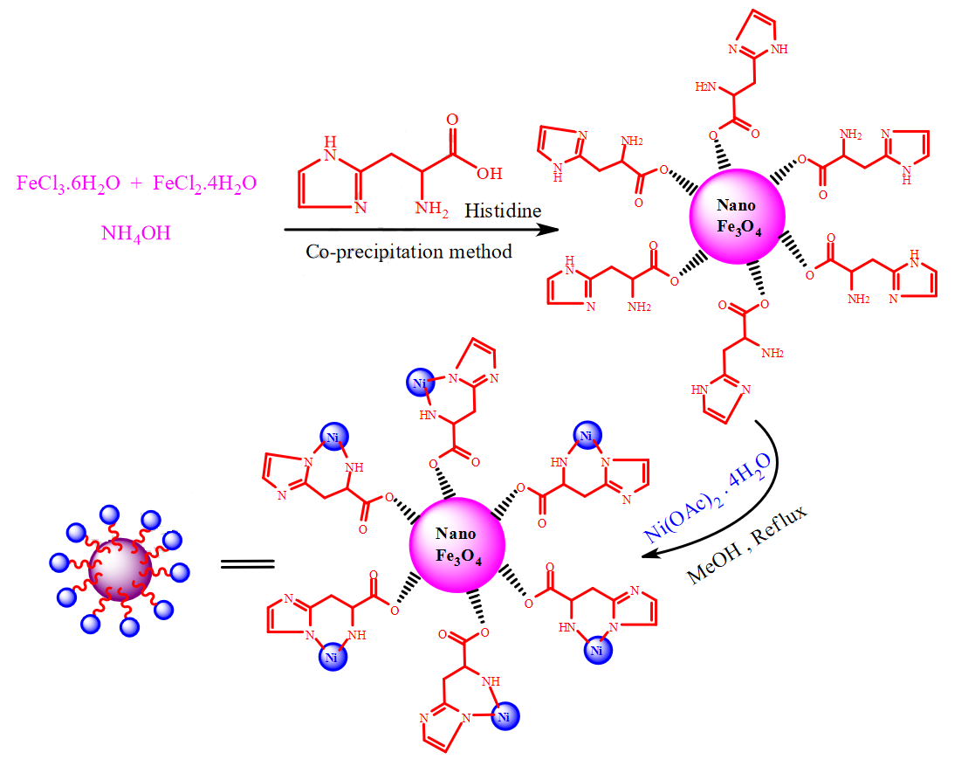
Nanoparticles applications in Covalent Bonding

Slide 13
Nanoparticles Applications in hydrogels
Incorporation of MNPs into hydrogel networks results in hydrogel magnetic nanocomposites, i.e., ferrogels in which the MNPs are stabilized by cross-linked gel networks. This can result in superior interaction between the MNPs and the gel networks thereby improving their mechanical properties.

Slide 14
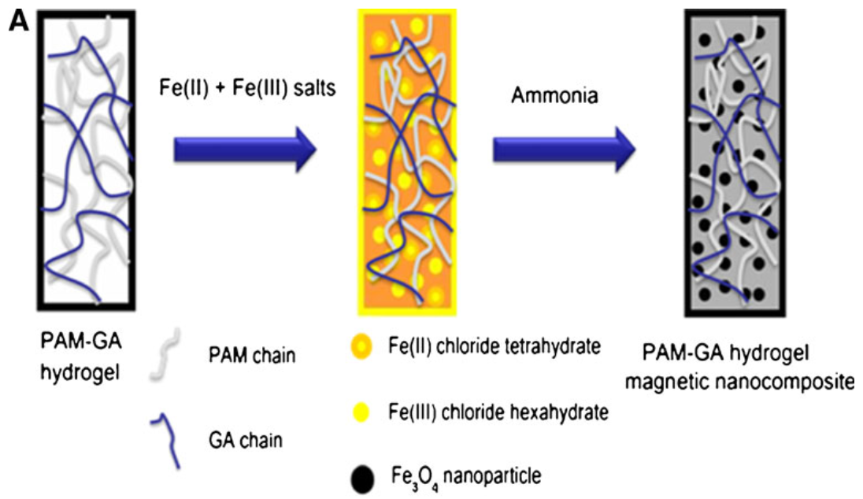
Nanoparticles applications in hydrogels

Slide 15


